Slide 1
WELCOME TO OUR PRESENTATION

Slide 2
“Online Bus Ticket Reservation System”
Presented By
Kashmery Aktar, Student Id:1420109
Shadequl Islam, Student Id:1420118
Sohel Rana , Student Id:1420119
B.Sc. in C.S.E
Level 4 Semester II
SASTC,Baliadangi,Thakurgaon

Slide 3
Outline
Introduction
Problem statement
Online bus ticket reservation system
Objectives
Why we choose this model
Related Works
Proposed Method
Modules identified
Tools and Technology
ER diagram for proposed system
Flowchart for proposed system
Services of the system
Conclusion and Future Work

Slide 4
Introduction
Problem statement
Manual bus reservation system is
Time consuming
Sometimes need to queue up to get the bus ticket.
counter just used to sell the bus ticket.
There are various system is developed which are web based . Many of them are not
flexible
user friendly and
maintainable.
In the implementing system, all this work will be done in a computerized system and reducing various problem of previous system.

Slide 5
Introduction(con’t)
Online Ticket Booking System
Online bus ticket booking system is windows based application. That works with centralized network. It provides facility to reserved seat, cancellation seats and different type of enquiry which need an instant and quick reservation.
E-ticket is the easier and quickest way to take bus.

Slide 6
Introduction(cont’d)
Objectives
To provide computer based system to overcome lack in current manual system
To introduce a digital way of booking bus ticket
Making the reservation system faster, user friendly
To implement transaction in banking system.

Slide 7
Introduction(con’t)
Why using this model
It is easier to test and debug during a smaller iteration
All the information provide to customer accurately
Records are efficiently maintained by DBMS
This model is more secure
This model is more flexible
Lowers initial delivery cost
High speed.

Slide 8
Related Wroks
Author Name | Title of papper | Technology used
A. Y. A. M. S. Uddin (12 Feb 2014) | E-Wallet System for Bangladesh an Electronic Payment System | .NET Framework, MS access, PHP, MySQL
David Otieno and Samantha Akinyi (November 2013) | “Residential online booking system” | VB.NET and, HTML, PHP, CSS Backend:-MS- Access, MySQL
Mahajan madhuri vikas (2004-2005) | “Travel reservation system” | PHP,mysql. ms access, html, javascript, css, bootstrap

Slide 9
Proposed system
Modules identified
Login module
Route module
Journey date and destination module
Bus info module
Ticket booking module
Payment module

Slide 10
User and admin activity
Admin activity
Add bus with place:
Add company
Add location
Booking ticket view
Confirming ticket
View user message
User activity
Select route and date of journey
Select desired bus and seat number
Payment
View booking details

Slide 11
Tools and technology used
PHP
JavaScript
MySQL
HTML
CSS
Bootstrap

Slide 12
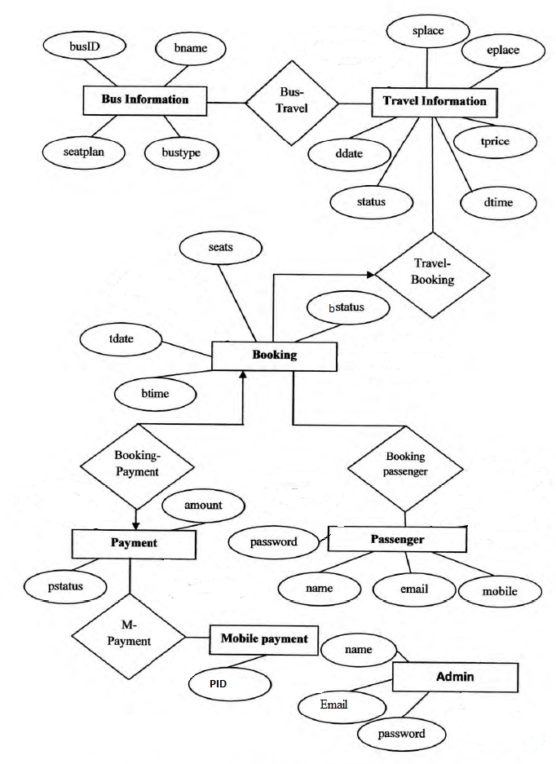
ER diagram
Entity Bus information Travel information Booking Passenger Payment Admin | Attributes Busid, bname, seat plan, bus type Splace, eplace, tprice, dtime,status,ddate Btime,tdate,btime, bstatus, seats Mobile, email, name, password Pstatus, amount. paymentid Name, email, password

Slide 13
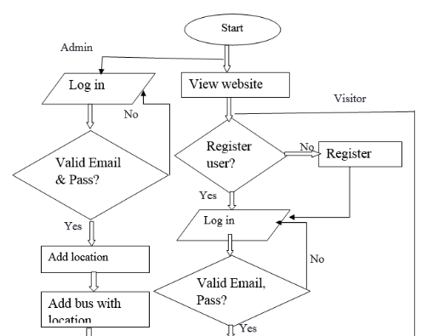
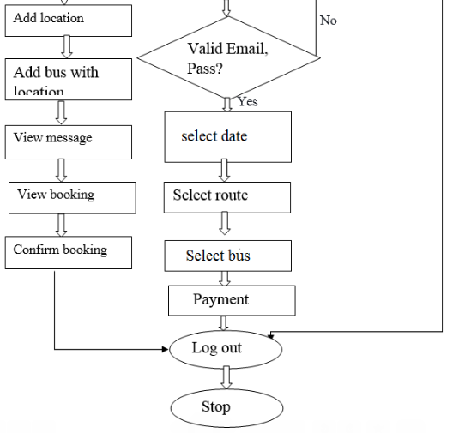
Flow chart for proposed system

Slide 14
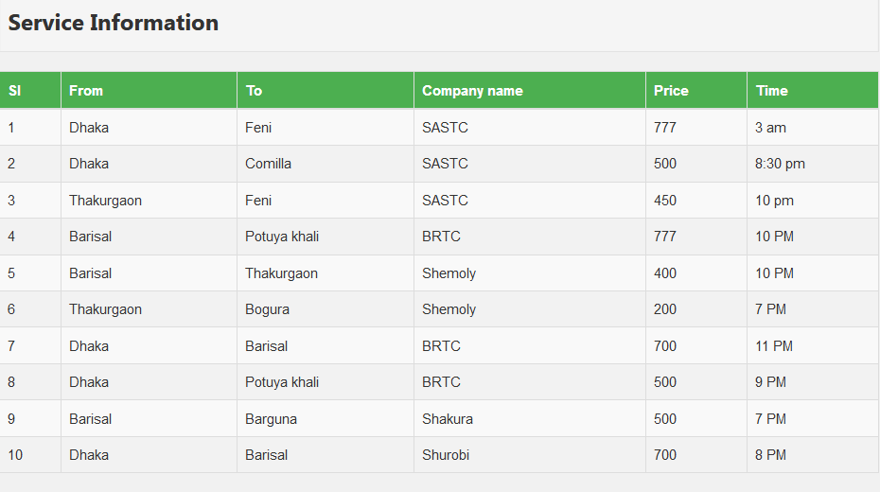
Services

Slide 15
Major limitation of the system
The system is developed without linked to electric banking system (EBS).
No notification can be sent during the starting time of bus.
No facility to print out ticket information as hardcopy.

Slide 16
Conclusion
Online bus ticket reservation overcome the difficulties encountered with the manual system.
It will also reducing the workload of the staff, reduce the time used for making reservation at the bus terminal and also increase efficiency.
The application also has the ability to update records in various files automatically thereby relieving the company’s staff the stress of working from file security of data.

Slide 17
Future work
Develop mobile application, since it is more easy to use develop a version for fees collection in public transport
Provide SMS based alerts and email notifications for bookings.
Design the system to provide worldwide travel facilities
Established the system which is able to make payment through electric banking system to achieve the payment process.
Chat feature can be included in the application to chat with customer care.
Check whether the seats are arranged in proper manner like the neighbors of the ladies should be ladies.
Design the system to provide worldwide travel facilities.
Provide payment protection.
Design the system to online fraud prevention.

Slide 18
THANK YOU

